Slide 1



BTEC L3 Travel + Tourism
Unit 1: The World of Travel + Tourism
Learning Aim B: The types of travel + tourism organisations, their roles and the products and services they offer to customers
B1. Ownership + operating aims
B2. The key sectors of the travel and tourism industry – components of their role,
and the products and services they offer to different types of customer
B3. Interrelationships and interdependencies in the travel and tourism industry
B4. Technology in travel + Tourism

Slide 2
BTEC L3 Travel + Tourism
Assessment outcomes
AO1 Demonstrate knowledge and understanding of the travel and tourism industry, types of tourism and organisations involved
Command words: complete, describe, give, identify, outline
Marks: ranges from 2 to 4 marks
AO2 Apply knowledge and understanding of the travel and tourism industry and factors affecting the industry to real-life travel and tourism scenarios
Command words: analyse, assess, calculate, describe, discuss, evaluate, explain
Marks: ranges from 4 to 12 marks
AO3 Analyse information and data from the travel and tourism industry, identifying trends and the potential impact of different factors on the industry and its customers
Command words: analyse, assess, discuss, evaluate
Marks: ranges from 6 to 12 marks
AO4 Evaluate how information and data can be used by the travel and tourism industry to make decisions that affect organisations and customers
Command words: analyse, assess, discuss, evaluate
Marks: ranges from 6 to 12 marks
AO5 Make connections between the factors that influence the travel and tourism industry and how the industry responds to minimise the potential impact on organisations and customers
Command words: analyse, assess, discuss, evaluate
Marks: ranges from 6 to 12 marks

Slide 3
BTEC L3 Travel + Tourism
Summary of assessment
This unit is assessed by a written examination set and marked by Pearson.
The examination will be 90 mins in length.
The number of marks for the examination is 75.
The assessment availability is January and May/June each year.

Slide 4
BTEC L3 Travel + Tourism
Content
B1. Ownership and operating aims
Each type of organisation has different aims that it needs to achieve.
• Private:
o characteristics – owned by private individual(s) or company, may be a public limited company (PLC) on stock market, could be large multinational company, may be SME (small to medium-sized enterprise), will be staffed by paid employees
o aims – usually financial, to make a profit, to increase market share, to increase turnover, to improve or maintain its image, to increase and diversify the range of products/services offered to customers
o organisations – tour operators, travel agents, most transport organisations and hubs, most large visitor attractions, most accommodation providers.
• Public:
o characteristics – owned or funded by the government – local or national, will be
staffed by paid employees but may also be supported by volunteers
o aims – to provide a service to the public, to use funding appropriately, to maintain best quality service, to financially break-even, to ensure that service levels are maintained to reinvest profit to improve services
o organisations – tourist information centres, tourist boards, some smaller visitor attractions, some local transport organisations, most regulatory bodies, government bodies.
• Voluntary sector:
o characteristics – funded by grants, donations, legacies, entry fees, staffed by volunteers though larger organisations, will also have paid employees or tenants, most have charitable status
o aims – to preserve or protect the environment, buildings, landscape features; to campaign or lobby against inappropriate developments; conservation; sustainability
o organisations – some visitor attractions, including natural; some transport; charities.

Slide 5
BTEC L3 Travel + Tourism
Content
B2 The key sectors of the travel and tourism industry – components of their role, and the products and services they offer to different types of customer
Each key sector will comprise a range of organisations, from small, local companies to large, multinational businesses, and examples of organisations for each sector will need to be provided. Products and services may be tangible or intangible.
• Transport principals:
components:
– air (scheduled, charter, low cost or no-frills) – sea (ferry, cruises) – road (bus, coach, hire car, private car, taxi)
– rail (local, national and international, high speed)
Role: to provide transport between destinations, to ensure safety
Products and services: transport for passengers and luggage, catering, entertainment, information, shopping.
• Transport hubs and gateways:
components:
– airports – rail and coach stations – ferry and cruise ports
Role: to provide access for passengers to transportation, to ensure safety
Products and services: check-in desks, information, catering, shopping, lounge facilities.
Tour operators:
o components:
– mass-market, package
– special interest, niche, luxury – tailor-made, dynamic packages
o role – to assemble and operate package holidays comprising two or more products or services at an inclusive price. The packages then can either be sold directly or through travel agents
o products and services – package holidays, accommodation, transfers, excursions, information on destinations, representative service in resorts.

Slide 6
BTEC L3 Travel + Tourism
Content
Travel agents:
o components:
– retail or high street, multiple, miniple, independent, franchised, specialist – online or web-based
– call centres
– business, conference and incentive
o role – to provide expert advice and guidance; arranging and booking transport and package holidays or individual components and ancillary items
o products and services – information on destinations and transport; holiday brochures; all types of package holidays; individually booked components – tailor-made packages; accommodation; flight only; ferries; cruises; coach tours; transfers, both in UK and overseas; excursions; holiday insurance; foreign exchange; passports, visas and health advice to travellers.
Visitor attractions:
o components:
– natural areas – national parks
– natural features – beaches, caves, cliffs, mountains, hills, waterfalls, islands, forests
– purpose built or man-made – theme parks, museums, art galleries
– historical or heritage – castles, walls, ruins, towers, monuments, religious, houses, palaces – sports – spectating, participating, stadium tours
– special events – markets, festivals, parades, exhibitions
o role – to provide entertainment, education, recreation, hospitality, special events, and facilities for visitors – parking
o products and services – rides, experiences, interpretation, guidebooks, information boards, exhibits, guided tours, educational talks, hospitality, gift and souvenirs shops, catering.

Slide 7
BTEC L3 Travel + Tourism
Content
Accommodation:
o components
– catered accommodation
– hotels (star rated, spa, golf resorts)
– bed and breakfasts, guest houses, chalets (in ski resorts) – youth hostels
o component
– self-catered or non-catered accommodation – cottages, apartments, boats, log cabins, chalets
– motels, aparthotels. – caravans, static or touring – motorhomes – tents, including glamping, yurts, tepees
o role
– to provide different accommodation options according to customer type,
needs and budget
o products and services:
– catered – room, reception, restaurant and bar, housekeeping, leisure facilities, gym or health club, conference and business facilities, entertainment
– self-catered – rooms, kitchen, tent or caravan pitch, entertainment, sports facilities, amenities such as laundry and showers.
Trade associations, government departments and regulatory bodies:
o components:
– ABTA, The Travel Association
– Association of National Tourist Office Representatives (ANTOR)
– Association of Independent Tour Operators (AITO)
– Civil Aviation Authority (CAA) which issues the Air Travel Organisers Licence (ATOL) – International Air Transport Association (IATA). – Department for Culture Media and Sport (DCMS). – Foreign and Commonwealth Office (FCO)
o roles – to provide information and support to organisations; to define, apply and ensure compliance with rules and regulations which ensure safe operations;
to protect customers financially; to ensure high standards; to lobby the government on behalf of customers and organisations; to repatriate travellers
o products and services – logos, charters, agreements, bonds, repatriation arrangements, arbitration service, compensation schemes.

Slide 8
BTEC L3 Travel + Tourism
Content
Information and promotional service providers:
o components:
– United Nations World Tourism Organisation (UNWTO)
– VisitBritain, VisitEngland, Tourism NI (Northern Ireland), VisitScotland, VisitWales – destination management organisations (DMO)
– regional
– local tourist information centre
o role – to provide information to organisations and customers or prospective customers; to market and promote destinations and organisations; to sell products, merchandise and services relating to location; to research and produce statistics
o products and services – brochures, leaflets, websites, mailing lists, merchandise.

Slide 9
BTEC L3 Travel + Tourism
B3 Interrelationships and interdependencies in the travel and tourism industry
Organisations in different sectors interrelate and some larger organisations have integrated either horizontally and/or vertically. These have potential advantages and disadvantages to both the organisations and their customers.
Distribution channels–direct to customer, through an intermediary company.
Interrelationships–defined as ‘organisations that work together to benefit them both’.
Interdependencies–defined as ‘organisations that rely on each other to enable them to provide a better product or service to the customer’.
Potential advantages of interrelationships and interdependencies–shared costs and economies of scale, increased sales, better image, reputation, customer care, more customers, more income.
Potential disadvantages of interrelationships and interdependencies –loss of individual image, less personal customer service, shared commission on sales, effects of poor service by one organisation may potentially impact on the other.
Horizontal integration–where an organisation buys or merges with another organisation of the same type to enable it to offer a wider variety of products and services.
Vertical integration– when an organisation buys or merges with another organisation of a different type to enable it to control more sectors of the market.
B4 Technology in travel and tourism
Technology, including mobile and digital technology, is used by different organisations in the industry, and there are potential advantages and disadvantages of its use to both businesses and their customers.
Technology for communication, booking and promotion:
o ebrochures and websites o reviews, blogs, virtual tours, videos o mailshots, popups, adverts
o making and confirming bookings o emailing tickets and vouchers o apps for mobile and digital devices.
Technology specific to different organisations:
o visitor attractions – multimedia presentations, animatronics, interpretation,
fast-track tickets, webcams
o transport hubs and gateways – self-service check-in, body and baggage scanners o accommodation, for check-in, for in-room entertainment, for information
o travel agents, transport principals and tour operators – for eticketing, mticketing,
payment systems, displaying availability, seat selection.

Slide 10
BTEC L3 Travel + Tourism
B. The types of travel and tourism organisations, their roles and the products and services they offer to customers
B1. Ownership + operating aims
Nature
Classification
Size
Global or international
Manufacture goods
Primary
Local
National
Local or national
Regional
Global
Supply goods
Supply
services
Tertiary
Secondary
Regional
Ownership
Sole trader
Government
Private
limited
Public
limited
Voluntary
Charity
Cooperative
B1. Ownership + operating aims

Slide 11
BTEC L3 Travel + Tourism
B. The types of travel and tourism organisations, their roles and the products and services they offer to customers
B1. Ownership + operating aims
Private sector - Profit making businesses:
Aims to make a profit, grow market share, increase revenue,
diversify products/services, create brand recognition etc.
Sole trader business is usually a small business, own by one person. No limited liability – so personally responsible for all debts.
Private limited company owned by shareholders. Shares bought + sold with permission of shareholders. Limited liability means not personally liable for debt. Finances reported to Companies House, but not made public.
Sole trader
Public limited company (PLC) is owned by shareholders. Shares can be bought and sold by anyone on the stock exchange. If the business makes a profit the shareholders receive a share of the profit – a dividend.
Private
limited
Public
limited
Examples:
Examples:
B1. Ownership + operating aims

Slide 12
BTEC L3 Travel + Tourism
B. The types of travel and tourism organisations, their roles and the products and services they offer to customers
B1. Ownership + operating aims
Public organisations:
Largely owned and funded by the government – Department for Digital, Culture Media + Sports (DCMS)
Funding: central government grants, local government, lottery funding etc.
Government oversees directly or indirectly a large number of T+T organisations.
DCMS is responsible for national tourist boards + agencies – Visit Britain, Visit Scotland, Visit England, Visit Wales, Visit NI + local tourist information centres.
Government is also responsible for many of the most popular tourist attractions – major museums.
The government sets out the criteria that funded organisations must meet, including:
. operate to at least break-even point
. reinvest any profits back into their products/services
. provide value for money with the funds they receive
. provide the highest quality customer service
Most employees are paid but many have volunteers.
Government
Voluntary sector organisations are usually charities and get funding from:
. government (grants, loans etc)
. donations from the public
. entry fees, parking, merchandise etc
Voluntary
Charity
Cooperative
Charities are regulated by the Charity Commission. They are non profit – this means any profits are used for their cause, reinvested
Aims of charities differ but may include:.
. reserve and protect the environment – landscape, buildings etc
. be sustainable – minimise impact
. promote arts, science, culture + heritage
. inform and educate visitors
. promote community development
B1. Ownership + operating aims

Slide 13
BTEC L3 Travel + Tourism
B. The types of travel and tourism organisations, their roles and the products and services they offer to customers
B2. The key sectors of the travel + tourism industry - components of their role, and the products and services they offer to different types of customer
Different sectors offer a range of T+T products and services. The sectors are interdependent upon each other.
Products + services can be:
Tangible – something that is a physical item Intangible – an experience; sightseeing, visitor attraction
Transport principals
Information + promotional service providers
Transport hubs + gateways
Regulatory bodies
Travel +
Tourism
Industry
Tour operators
Government departments
Travel agents
Trade associations
Visitor attractions
Accommodation
B2. Key sectors of the travel + tourism industry

Slide 14
BTEC L3 Travel + Tourism
B. The types of travel and tourism organisations, their roles and the products and services they offer to customers
B2. The key sectors of the travel + tourism industry - components of their role, and the products and services they offer to different types of customer
Transport hubs + gateways
Terms gateway and hub are often interchanged – many ‘hubs’ are in fact gateways, where there are different modes of transport available even if it is primarily one mode e.g. railway station
Transport gateways and hubs are locations where transport converges and are
connected to other hubs and locations
Transport
hubs + gateways
Gateway
Hub
Sea Land
Corridor
Land
Gateways are where you can change from one mode of transport to
another e.g. plane to train.
Hubs connect the same mode of transport
e.g. train to another train
B2. Key sectors of the travel + tourism industry

Slide 15

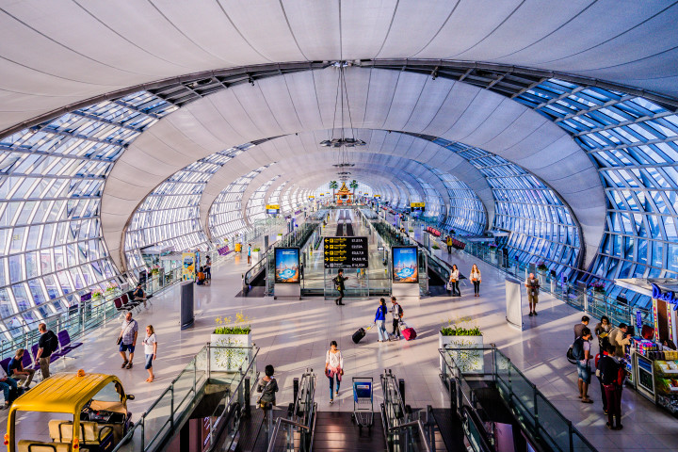
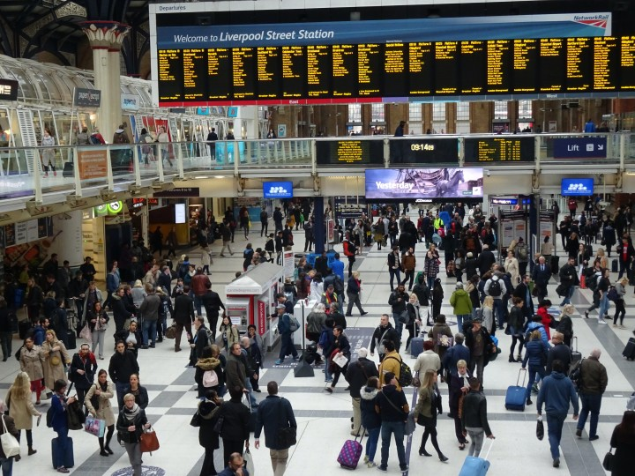
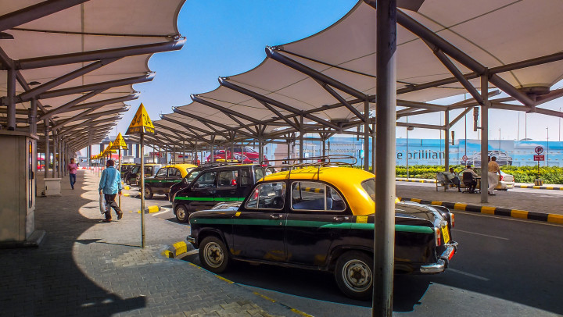
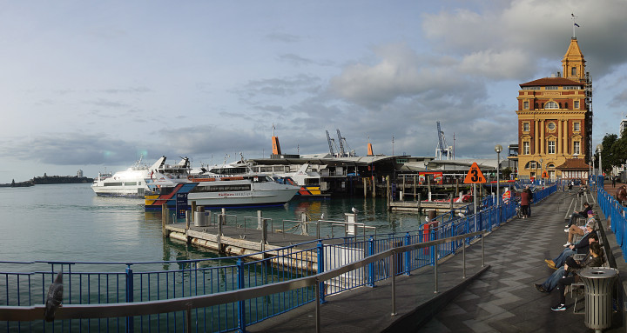
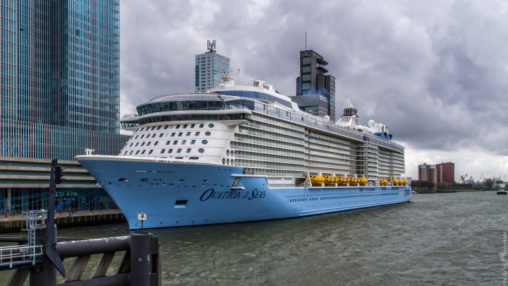
BTEC L3 Travel + Tourism
B. The types of travel and tourism organisations, their roles and the products and services they offer to customers
B2. The key sectors of the travel + tourism industry - components of their role, and the products and services they offer to different types of customer
Airport terminal
Rail terminal
Transport
gateways
+ hubs
Connecting from one train to another or on a corridor,
perhaps connecting with other land transport - taxi or bus
Connecting from one flight to another (in transit) or one flight perhaps connecting with other land transportation
Ferry terminal
Cruise terminal
Connections with land transport
Connections with land transport
B2. Key sectors of the travel + tourism industry

Slide 16
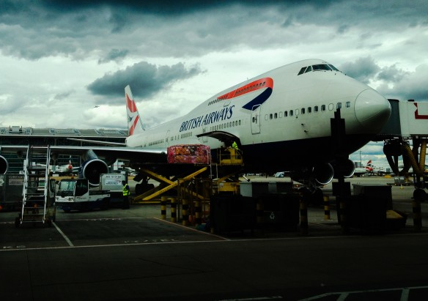

BTEC L3 Travel + Tourism
B. The types of travel and tourism organisations, their roles and the products and services they offer to customers
B2. The key sectors of the travel + tourism industry - components of their role, and the products and services they offer to different types of customer
Air transport – types of lights
. domestic - within the country
international - country to country
. direct flights – not stopping
indirect flights – via other airports
Scheduled flights
(a regular timetabled service – summer/winter service)
Full service = include entertainment, refreshments, check-in baggage etc (Virgin, British Airways, Emirates)
Economy – food + drink, baggage (20-24kgs)
Premium economy – wider seat + extra baggage
Business – special menu, (champagne inc.) seat/bed, own departure lounge, generous baggage
First – personal suite, luxury bed, pjs, special menu
National carriers
Represent their country – sometimes owned
or part owned by the government
Transport principals:
AIR
TRANSPORT
Chartered flights
For package tour holidaymakers to holiday destinations.
Tour operators pre-book seats on the flights or have their own chartered airline (TUI).
International and domestic flights
Airlines in most countries fly domestic routes
and international routes
e.g. United Airlines, American Airlines, Lufthansa, British Airways, China Southern Airlines
Many of these airlines have more than one base e.g. British Airways = Heathrow and Gatwick
Low cost airlines – budget = keep costs low with online booking, limited or no entertainment, charge extra for priority booking baggage, refreshments etc. (EasyJet, Ryanair)
Private jet hire - individuals or businesses ‘charter’ a flight for a specific destination
B2. Key sectors of the travel + tourism industry

Slide 17
BTEC L3 Travel + Tourism
B. The types of travel and tourism organisations, their roles and the products and services they offer to customers
B2. The key sectors of the travel + tourism industry - components of their role, and the products and services they offer to different types of customer
Airports
Terminals for all flights or for: domestic - within the country and international - country to country
Cater to inbound and outbound passengers
Ownership
UK only country to have airports fully privately owned.
Some smaller airports are publicly owned –
Newquay = Cornwall County Council.
Airports not only provide a range of airline services
but also a variety of connected services
e.g. accommodation, transport and information
Services, to enhance the customer experience.
These associated businesses pay rent to the airport to operate there, adding the airport’s revenue.
List the facilities at LHR
Transport
hubs + gateways:
AIPORTS
B2. Key sectors of the travel + tourism industry

Slide 18
BTEC L3 Travel + Tourism
B. The types of travel and tourism organisations, their roles and the products and services they offer to customers
B2. The key sectors of the travel + tourism industry - components of their role, and the products and services they offer to different types of customer
Research Emirates Airlines and list the extra benefits that Business and First Class passengers receive
Business
First
B2. Key sectors of the travel + tourism industry

Slide 19
BTEC L3 Travel + Tourism
B. The types of travel and tourism organisations, their roles and the products and services they offer to customers
B2. The key sectors of the travel + tourism industry - components of their role, and the products and services they offer to different types of customer
List the advantages and disadvantages of these types of airlines
National carriers
Examples
Budget airlines
Examples
ADVANTAGES
DISADVANTAGES
B2. Key sectors of the travel + tourism industry

Slide 20
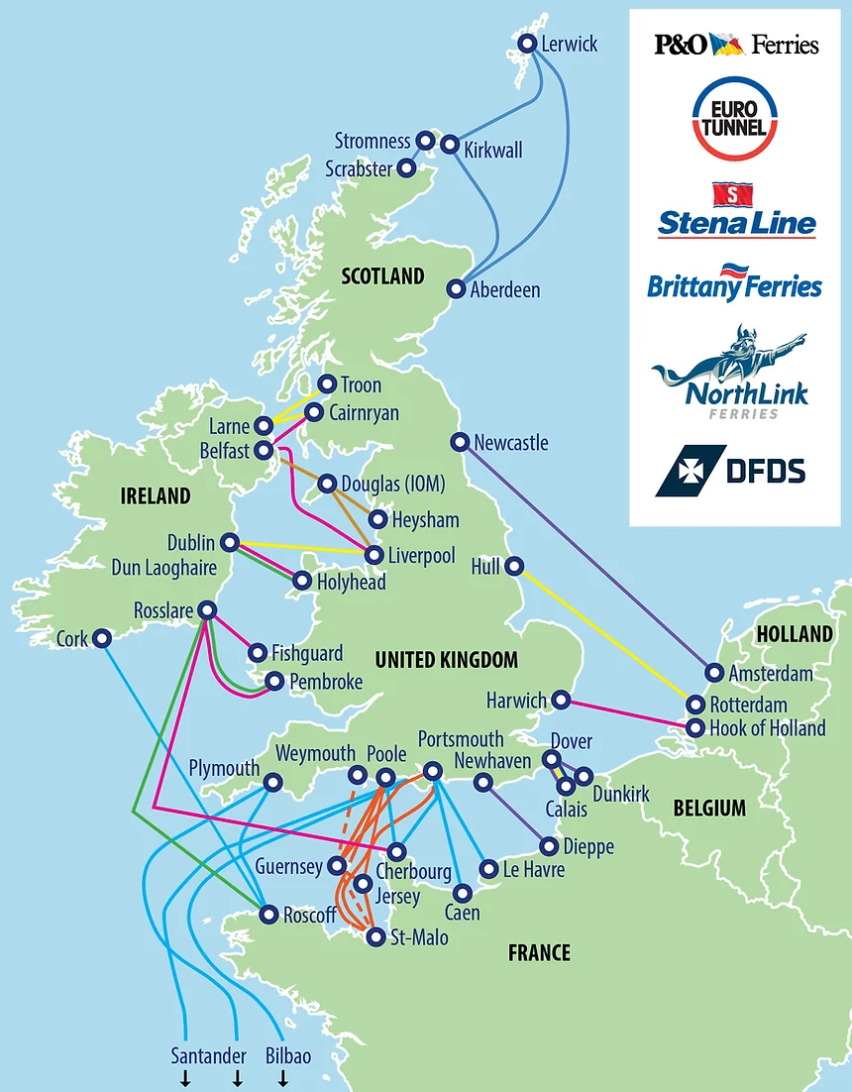
BTEC L3 Travel + Tourism
B. The types of travel and tourism organisations, their roles and the products and services they offer to customers
B2. The key sectors of the travel + tourism industry - components of their role, and the products and services they offer to different types of customer
Ferries
As a group of islands the UK has a large number of ferry services to a number of countries offering a service for passengers with and without vehicles.
Ferry Terminal is a location for the boarding,
departure, or arrival of a ferry service.
Ferry terminals cater to freight and passengers.
Passengers can either be walk on or with a vehicle
– car or coach.
Large ferry terminals have facilities similar to airports:
. Shops . Currency exchange. Food & drink
.Toilets/Showers/Baby changing. . First aid
. Internet access . Left luggage . Car charging points
Ferry terminals are part of an integrated transport system connected to taxis, buses, coach and train services
Transport principals:
SEA
TRANSPORT
Water taxis:
Airports & sea ports to destination (Maldives)
Taxis across rivers + lakes
B2. Key sectors of the travel + tourism industry

Slide 21
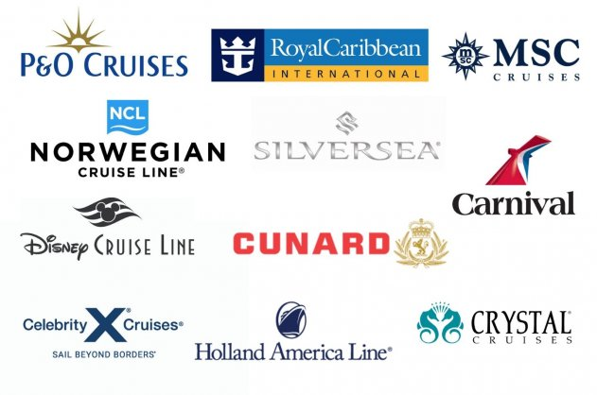
BTEC L3 Travel + Tourism
B. The types of travel and tourism organisations, their roles and the products and services they offer to customers
B2. The key sectors of the travel + tourism industry - components of their role, and the products and services they offer to different types of customer
Cruises
Oceans, sea, rivers and lakes
River cruises
. Increasingly popular esp. in Europe on the Rhine, Danube, Moselle and Nile in Egypt and in the USA on the Mississippi, Colombia + Great Lakes
Facts:
. Passengers: 26.7 million
. Jobs: 109,000
. Revenue: $134 billion
Growing 4% pa with 19 new ships due
to launch in 2020
Transport principals:
SEA
TRANSPORT
Key benefits:
. All inclusive
. On board entertainment
. Visit a range of cities + countries (1 a day)
Cruises in creasing popular across the
age groups, themed cruises for target market
Main sea cruise companies
Carnival Cruise Lines
Celebrity Cruise Lines
Costa Cruises
Royal Caribbean
Holland America
Norwegian Cruise Line
Star Cruises
P&O Princess
Origin of cruise passengers:
United States 11.9
China 2.4
Germany 2.19
United Kingdom 1.93
Australia 1.34
Canada 0.92
Passengers in Millions
B2. Key sectors of the travel + tourism industry

Slide 22
BTEC L3 Travel + Tourism
B. The types of travel and tourism organisations, their roles and the products and services they offer to customers
B2. The key sectors of the travel + tourism industry - components of their role, and the products and services they offer to different types of customer
List the advantages and disadvantages of ocean cruise holidays
Advantages
Disadvantages
B2. Key sectors of the travel + tourism industry

Slide 23
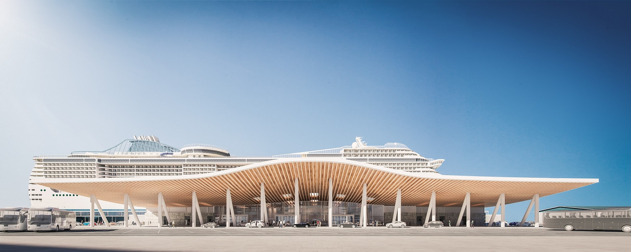
BTEC L3 Travel + Tourism
B. The types of travel and tourism organisations, their roles and the products and services they offer to customers
B2. The key sectors of the travel + tourism industry - components of their role, and the products and services they offer to different types of customer
Southampton is home to leading cruise companies and ships including:
P&O Cruises – Arcadia, Aurora, Azura, Britannia, Oceana and Ventura
Celebrity Cruises – Celebrity Silhouette
Cunard – Queen Victoria, Queen Elizabeth and the Transatlantic liner Queen Mary 2
Princess Cruises – Royal Princess and Sapphire Princess
Royal Caribbean - Independence of the Seas and Navigator of the Seas
Many other cruise ships call into Southampton
Cruise terminals
Example: Southampton
Southampton has 4 cruise terminals:
QEII, Ocean, City, and Mayflower
Deep water berths means it can accommodate
any size cruise ship
Southampton unusually has high water for 80% of
the time, meaning it has easy access for cruise ships
Cruise terminal handles 500 ships per year - 2 million passengers
Destinations include:
. mini-cruises to France, Belgium and Holland as well as l
. long Mediterranean cruises in summer
. world cruises with several ‘legs'
Popular itineraries for cruises from Port Southampton include:
Iceland and Greenland; the Norwegian Fjords and Baltic Sea; the Mediterranean; Iberia and Gibraltar; the Canary Islands; Black Sea to Turkey, Bulgaria, Ukraine and Russia; Transatlantic cruises (either seasonal repositioning or aboard the majestic QM2.
.
Transport
hubs + gateways:
CRUISE
TERMINALS
Facilities
Hotels – some local hotels offer ‘cruise packages’, one night stay + breakfast + transfer to cruise terminal
Shuttle transfer from Heathrow etc, Car parking, Restaurant, Shops, Toilets, Internet – Shopping centre nearby
Fifth new cruise terminal
at Southampton
B2. Key sectors of the travel + tourism industry

Slide 24



BTEC L3 Travel + Tourism
B. The types of travel and tourism organisations, their roles and the products and services they offer to customers
B2. The key sectors of the travel + tourism industry - components of their role, and the products and services they offer to different types of customer
Coaches
Buses
. Coach travel can be part of a package or as separate holiday or a mode of transport.
. Coach travel is often a multi-centre holiday, where people visit a number of places
. Coach day trips are popular to attractions and events.
. Coach trips can cheap travel option (or for those who do not like to fly) and are popular in the ‘grey market’.
. Coach travel between airports and cities and city to city is a cost effective way to travel
. Coaches have become more luxury with toilets, Wifi, onboard entertainment + refreshments.
Buses provide a cheap and convenient way to travel especially in large towns and cities where the service is regular. Rural areas have less frequent services.
Sightseeing tours – like Big Bus – provide ‘hop-on hop-off’ services as well as information about the city.
Transport
principals:
LAND TRAVEL
Underground
Underground trains (tube - metro) provide fast and convenient travel in many large cities around the world.
This form of transport like buses are popular with local and tourists
B2. Key sectors of the travel + tourism industry

Slide 25
BTEC L3 Travel + Tourism
B. The types of travel and tourism organisations, their roles and the products and services they offer to customers
B2. The key sectors of the travel + tourism industry - components of their role, and the products and services they offer to different types of customer
Coach terminals
Bus terminals
. Coach travel may be domestic or international
. Waiting time tends to less at coach terminals than airports therefore less facilities are needed
. Facilities may include:
. Toilets
. Waiting rooms
. Wifi
. Shops – food and drinks
. Left luggage
. Bus terminals may have basic facilities like toilets, food and drinks outlets.
. People at bus terminal tend to only be there for short periods so require less facilities.
. Covered or indoor seating areas are provided
Transport
hubs + gateways:
COACH + BUS
Underground stations
Underground stations vary enormously in terms of facilities offered. Some are linked to major rail terminals so share their facilities, whilst others may have toilets and food and drink kiosks.
Compare coach and bus terminals with airline terminals.
B2. Key sectors of the travel + tourism industry

Slide 26
BTEC L3 Travel + Tourism
B. The types of travel and tourism organisations, their roles and the products and services they offer to customers
B2. The key sectors of the travel + tourism industry - components of their role, and the products and services they offer to different types of customer
Compare coach and bus terminals with airline terminals.
B2. Key sectors of the travel + tourism industry

Slide 27



BTEC L3 Travel + Tourism
B. The types of travel and tourism organisations, their roles and the products and services they offer to customers
B2. The key sectors of the travel + tourism industry - components of their role, and the products and services they offer to different types of customer
Hire cars
Taxis + Ubers
. Hire car (or rental) companies operate in most towns and cities. Some are local, others are national or international companies
. They offer:
. a range of vehicles to suit customer needs
. airport pickup and drop-off
. one way hire
. insurance cover
Taxis + Ubers are used primarily for short journeys. Tourists more likely to use taxis that they can hail in the road.
Taxis are also used for airport and railway station drop offs and pick-ups.
Transport
principals:
LAND TRAVEL
What are the advantages of hiring the car as a form of transport for families
Private cars
Most domestic holidays + visits use cars as the primary mode of transport.
Private cars are the most convenient ways for most people but traffic congestion can be problem.
B2. Key sectors of the travel + tourism industry

Slide 28
BTEC L3 Travel + Tourism
B. The types of travel and tourism organisations, their roles and the products and services they offer to customers
B2. The key sectors of the travel + tourism industry - components of their role, and the products and services they offer to different types of customer
What are the advantages of hiring the car as a form of transport for families
B2. Key sectors of the travel + tourism industry

Slide 29
BTEC L3 Travel + Tourism
B. The types of travel and tourism organisations, their roles and the products and services they offer to customers
B2. The key sectors of the travel + tourism industry - components of their role, and the products and services they offer to different types of customer
Rail
Railway holidays
National and international networks
. rail networks link airports, sea ports etc with major towns and cities and include international routes (Eurostar runs from London to Paris
via tunnel)
Standards
. vary from country to country - often need government subsidy
or are totally owned by governments
. French TGV are high speed trains designed for tourists
. Different classes of seat
. Fast travel and cheap if booked in advanced
Rail tours & holidays
Short or long distance
Luxury (Orient Express)
Heritage (Tourist attraction)
Compass Tours
DPS Rail tours
Stobart Pullman
Pathfinder Tours
Scottish Railway Preservation Society
Venice-Simplon Orient Express
Vintage Trains
Retro Rail tours
Green Express Rail tours
Kingfisher Rail tours
Transport
principals:
LAND TRAVEL
Scheduled rail operators
Short and long distance – many or few stops
Intercity: East Coast – West Coast – Midlands – Great Eastern – Great Western
Regional: Network South East – North East – North West - Scotland
Local: Docklands – Mersey rail – Wrexham & Shropshire
B2. Key sectors of the travel + tourism industry

Slide 30
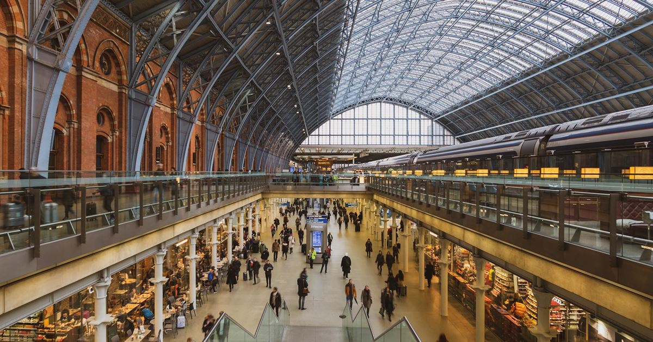
BTEC L3 Travel + Tourism
B. The types of travel and tourism organisations, their roles and the products and services they offer to customers
B2. The key sectors of the travel + tourism industry - components of their role, and the products and services they offer to different types of customer
Rail terminal
Facilities
Hotels, Car parking, Restaurants, Bars, ATMs, Bicycle racks, Farmers’ market, Shops, Toilets + Showers, Left luggage, Internet, Bureau de Change
Departure lounge – including a dedicated Eurostar lounge
St. Pancras Station, London
Opened in 1868 – expansion and renovation in 2000s to include an International Terminus at a
cost of £800 million for the Eurostar – connecting the UK to France by rail via the Channel Tunnel.
Eurostar provides services to Germany, Italy, Netherlands and Spain.
Rail services via four railway companies to the Midlands and the South East.
Transport
hubs + gateway:
RAIL TERMINAL
Connections
Connected to King Cross station and connects to
all other London railway stations via the underground system.
Direct connections to London airports including Heathrow, London Gatwick, Luton and London City Airport.
Taxis and bus services available at the station.
Other rail terminals
London Waterloo is the busiest, Birmingham New Street busiest outside of London.
In London, Kings Cross = Euston serve the north
Waterloo the south and Paddington the south west.
Network Rail manages the rail lines + 18 stations
B2. Key sectors of the travel + tourism industry

Slide 31
BTEC L3 Travel + Tourism
B. The types of travel and tourism organisations, their roles and the products and services they offer to customers
B2. The key sectors of the travel + tourism industry - components of their role, and the products and services they offer to different types of customer
Package Holiday Directive (2018)
Defined what a package holiday is.
Previously packages were sold that had multiple contracts with different suppliers.
Tour
operators
Single contract
. All components combined under one contract
Example
. A traditional package sold by a travel agent
Multiple contracts
. Selection of services from the same place and pays for them
Example
. Website that offers a range of products/services
to create a package
Tour operators create holidays by putting different components together:
. Accommodation
. Transport
. Activities
Different packages are combined to meet the customer needs. All the package holiday details are contained in their brochure – in travel agents of online.
There are over 2,000 UK tour operators
. Selection of services for the same trip sold for a total price
. Different contracts for services combined
. Products and services that are added by a customer after the contact has been accepted.
. Package may allow specific add-ons – trips + meals
. Customer compiles a trip through linked website to a second trader to add components and customer details are passed on to conclude the booking.
. Flight booked online then on that website clicks through to recommended car hire company or hotel – a package is created, through two traders
B2. Key sectors of the travel + tourism industry

Slide 32



BTEC L3 Travel + Tourism
B. The types of travel and tourism organisations, their roles and the products and services they offer to customers
B2. The key sectors of the travel + tourism industry - components of their role, and the products and services they offer to different types of customer
Niche market - Special interest
Mass market
. Hundreds of tour operators offer specialised package holidays – often tailor-made to meet the customer needs.
. These holidays are considered to be in the niche market
. Niche can include:
. Specific destinations; adventure; safari; ski; eco etc
. Large tour operators may have niche brands selling specialist holidays e.g. TUI own Crystal Ski
. Other niche include Cox + Kings offer luxurious holidays that are created to meet individual needs
. Saga holidays cater for the over 50s market
. Mass market tourism has dominated for many years. Tour operators sell similar packages in different destinations that appeal to a broad section of holiday makers.
. Mass market tour operators make their profit through sell large numbers of similar value for money holidays. Each holiday has a low profit margin.
Tour
operators
Tailor-made + dynamic packages
. These types of holidays are growing in popularity as customers are becoming more experienced travellers and seek to customise their own holidays.
. Customisation can incorporate all aspects of the holiday; transport; accommodation; F+B; activities etc
. Travel agents specialise in offering this service
Research 5 specialist tour operators and identify the niche market
B2. Key sectors of the travel + tourism industry

Slide 33
BTEC L3 Travel + Tourism
B. The types of travel and tourism organisations, their roles and the products and services they offer to customers
B2. The key sectors of the travel + tourism industry - components of their role, and the products and services they offer to different types of customer
Research 5 specialist tour operators and identify the niche market
B2. Key sectors of the travel + tourism industry

Slide 34
BTEC L3 Travel + Tourism
B. The types of travel and tourism organisations, their roles and the products and services they offer to customers
B2. The key sectors of the travel + tourism industry - components of their role, and the products and services they offer to different types of customer
Travel agents
Role
. Travel agents create and arrange holidays for their customers
. Most cater for the leisure market – package holidays, whilst some specialise or cater to the business market
. Travel agents can be on high streets and/or online
. Provide advise + information on products and services
. Sell + book holidays
. Independents sell from a variety of providers
. Some agents linked to tour operators + sell own brands
. Travel agents receive a commission from the tour operators
. Customers can pay a fee for agents to put together a tailor-made package
Travel agents
Products + Services
. Provide information on travel + holidays
. Book travel + holidays - package and specialist
travel: flights; ferries; car hire + trains
accommodation: hotels; self-catering; camping etc
other services: airport parking; travel insurance; excursions; transfers etc
. Create tailor-made or dynamic package holidays
. Offer advise on passports, visa, health issues inc. vaccinations
What are the advantages of using a ‘high street’ travel agent over an online one?
B2. Key sectors of the travel + tourism industry

Slide 35
BTEC L3 Travel + Tourism
B. The types of travel and tourism organisations, their roles and the products and services they offer to customers
B2. The key sectors of the travel + tourism industry - components of their role, and the products and services they offer to different types of customer
What are the advantages of using a ‘high street’ travel agent over an online one?
B2. Key sectors of the travel + tourism industry

Slide 36
BTEC L3 Travel + Tourism
B. The types of travel and tourism organisations, their roles and the products and services they offer to customers
B2. The key sectors of the travel + tourism industry - components of their role, and the products and services they offer to different types of customer
Franchise
Multiple
Online
. Franchises sells the branded products of a company
. Receives a fee
Example: MTC Travel
. Multiples = 50+ branches
. Large PLCs – TUI + Hays Travel
. Online only
. Sell a range of products/services
Example: expedia.com lastminute.com
Miniple
Business
. Multiples = 5 - 50 branches
. Often is in regional area
Example: premier-travel.co.uk
. Business travel agent focus on business travel often for large companies
. Specialise in MICE
Travel agents
Independent
Specialist
. Independent = 1 - 5 branches
. Often family owned
Good reputation for personal service
Call centre
. Often independent agents
. Specialise in destinations of type of tourism: cycling; water sports etc
. Call centre dedicated agents
. Many large tour operators, airlines
have call centres
B2. Key sectors of the travel + tourism industry

Slide 37
BTEC L3 Travel + Tourism
B. The types of travel and tourism organisations, their roles and the products and services they offer to customers
B2. The key sectors of the travel + tourism industry - components of their role, and the products and services they offer to different types of customer
Visit attractions
Sports
. UK visitor attractions are important of domestic tourism + inbound tourists
Purpose: entertainment; education + recreation
Attraction facilities:
. Parking . Cafes/Restaurants
. Gift shops . Information (displays, apps etc)
. Sporting events in the UK and Globally attract visitors from around the world. The Olympics and Football World Cup are the biggest with Premier League, Wimbledon, Grand prix, Open Golf, London Marathon etc.
Man-made
Nature
. These sector covers a wide range of attractions from museums to theme parks.
. UK museums are world famous – British, V+A, Science, Natural History – and attract millions of visitors each year.
. Include: national parks (15); AONB; coastlines; mountains; lakes; parks and beaches
Visitor
attractions
Historical - heritage
Special events
. UK famous for its historic buildings. National Trust and English Heritage oversee many of these including: Stonehenge; Blenheim Palace; Kenilworth Castle; Edinburgh Castle etc
. Special events include festivals + parades which include: Notting Hill Carnival; Edinburgh Festival; Glastonbury, Reading music festivals
B2. Key sectors of the travel + tourism industry

Slide 38







BTEC L3 Travel + Tourism
B. The types of travel and tourism organisations, their roles and the products and services they offer to customers
B2. The key sectors of the travel + tourism industry - components of their role, and the products and services they offer to different types of customer
Accommodation
Catered of self catering. Different types and standards that meet different needs and budgets
Apartments
Self catered mainly in cities for family or groups.
B+B - Guest houses
Most are family run and provide breakfasts – sometimes dinner.
Facilities limited.
Hotels
Catered accommodation – business + leisure
Independent + chain hotels
Range of quality 1 – 5 stars + facilities
Different style of rooms (suite, double, twin)
Budget – Premier Inn
Luxury – Hilton
Facilities:
. Food + beverage (bars + restaurants)
. Swimming pool . Gym . Spa. . Toiletries
Business facilities:
. Meeting rooms. . Conference facilities
Camping + Caravans
Self catering – cheaper. Family focused. Clamping: yurts + tepees
Sites have a range of facilities
Accommodation
Air BnB
Provided by individuals - rooms or entire properties.
Usually self catered
Motels
. Roadside (motorway service stations) for motorists, offering bed (perhaps breakfast)
Very popular in large countries (USA)
Others
. Ski chalets
. Boats – narrowboats
. Log cabins
Hostels
. For ‘backpackers’ basic, cheap and communal
B2. Key sectors of the travel + tourism industry

Slide 39
BTEC L3 Travel + Tourism
B. The types of travel and tourism organisations, their roles and the products and services they offer to customers
B2. The key sectors of the travel + tourism industry - components of their role, and the products and services they offer to different types of customer
Accommodation | Type of visitor | Why is this accommodation appropriate
Hotel
Hostel
Campsite
City apartment
Air BnB
Guest houses -BNB
B2. Key sectors of the travel + tourism industry

Slide 40







BTEC L3 Travel + Tourism
B. The types of travel and tourism organisations, their roles and the products and services they offer to customers
B2. The key sectors of the travel + tourism industry - components of their role, and the products and services they offer to different types of customer
Trade associations, government departments and regulatory bodies
ABTA
Association of British Travel Agents
Tour operators + travel agents members follow code of conduct: accurate advertising; fair booking terms; customer complaints. Arbitration for customers.
CAA
Civil Aviation Authority
Regulates UK civil aviation. Statutory body that issues licences to fly. Tour operators must be members of ATOL and provide a bond. This bond is used if a company goes bankrupt to fly passengers home.
ANTOR
Association of National Tourist
Office Representatives
Represents tourist offices – chance to share ideas through networking. Comments on issues that affect the T+T industry
IATA
International Air Transport Association
Represents 265 world airlines. Creates and enforces safety measures for airlines. Travel agents have to sell tickets only for IATA airlines.
Trade associations, govt departments and
regulatory bodies
DCMS
Department Culture, Media + Sport
Govt. department responsible for tourism.
To promote UK tourism and T+T businesses
AITO
Association of Independent
Tour Operators
Represents tour operators – have a charter + code of business practice: truthful descriptions + get customer feedback to maintain standards
FCO
Foreign Commonwealth Office
Govt. department responsible for relations with other countries.
Gives travel advise – what the situation is in every country.
Where it is safe to travel. Responsible for bringing stranded citizens home.
B2. Key sectors of the travel + tourism industry

Slide 41
BTEC L3 Travel + Tourism
B. The types of travel and tourism organisations, their roles and the products and services they offer to customers
B2. The key sectors of the travel + tourism industry - components of their role, and the products and services they offer to different types of customer
Trade associations, government departments and regulatory bodies
Choose one organisation and explain its aims
B2. Key sectors of the travel + tourism industry

Slide 42




BTEC L3 Travel + Tourism
B. The types of travel and tourism organisations, their roles and the products and services they offer to customers
B2. The key sectors of the travel + tourism industry - components of their role, and the products and services they offer to different types of customer
Information + promotional service providers
Tourist boards - National
VisitBritain/England/Wales/Scotland/NI
. Aims of each is to promote tourism
. To promote and expand tourist economic activity
. Provide marketing materials (brochures, leaflets etc)
. Focus on special events
Example: Visit Britain promotes destinations outside of London
Aim: to develop and promote travel + tourism to improve economies and employment.
United Nations World Tourism Organisations
UNWTO responsible for the promotion of
sustainable = accessible tourism.
Members = 158 countries
. encourage sustainable tourism to improve local economies
. promote tourism to improve economy and peoples’ standard of living
. educate local population to take advantage of tourism opportunities
. tourism research to support members
e.g. identifying trends
Information + promotional service providers
Tourist boards – Regional
Each region promotes its local destinations + attractions as partners as well as local authorities and businesses
Tourist boards – Local
Tourist information centres funded by local councils, provide information on local attractions, accommodation, F+B, tours etc
Destination management organisations
DMOs coordinate the different components in a destination by building partnerships with the range of organisations e.g. attractions, transport + marketing
B2. Key sectors of the travel + tourism industry

Slide 43
BTEC L3 Travel + Tourism
B. The types of travel and tourism organisations, their roles and the products and services they offer to customers
B2. The key sectors of the travel + tourism industry - components of their role, and the products and services they offer to different types of customer
Tourist boards - National
VisitBritain/England/Wales/Scotland/NI
Research a national tourist board and list 5 events that they are promoting – how are they promoting each of these events?
Research a local tourist board and list 5 events that they are promoting – how are they promoting each of these events
B2. Key sectors of the travel + tourism industry

Slide 44

BTEC L3 Travel + Tourism
B. The types of travel and tourism organisations, their roles and the products and services they offer to customers
B3. Interrelationships and interdependencies in the travel and tourism industry
Distribution channels
Getting products and services to customers. This can be done direct to the customer or via travel agents
Distribution channels
Traditional distribution channel
Wholesalers
Retailers
Principals
Transport, Accommodation,
other suppliers
Tour operators
Travel agencies
Consumers
The variety of distribution channels is in part to meet different customer needs. Some still seek the knowledge of a travel agent whilst others are confident to book themselves.
Variations of distribution channels
Principal
Internet
Consumer
Principal
Call centre
Consumer
Principal
Tour operator
Advertising
Consumer
B3. Interrelationships and interdependencies in the travel and tourism industry

Slide 45
BTEC L3 Travel + Tourism
B. The types of travel and tourism organisations, their roles and the products and services they offer to customers
B3. Interrelationships and interdependencies in the travel and tourism industry
Interrelationships
Interdependencies
Organisations working together for mutual benefit.
Hotels work with tour companies
Rail companies promote destinations
Tesco Clubcard offers discounts for attractions.
Interdependent sees organisations relying on each other for success.
Airlines and airports work together to create a mutually beneficial business relationship.
Interrelationships and interdependencies
Advantages
. Economies of scale - sharing functions (admin, offices, aircraft)
. Shared advertising and promotions
. Increase in revenue as more customers reached through ads
. Benefit from each others reputation
. Share customer databases to promote products/services
Disadvantages
. Lose your own identity – confuse customers
. More generic – less personal, less specific
. A bad reputation for one can affect the good reputation of the other
B3. Interrelationships and interdependencies in the travel and tourism industry

Slide 46

BTEC L3 Travel + Tourism
B. The types of travel and tourism organisations, their roles and the products and services they offer to customers
B3. Interrelationships and interdependencies in the travel and tourism industry
Horizontal integration
Vertical integration
When an organisation joins (merges) with another of the same type – airline with airline
When a business merges or buys another that has a different role in the same industry – airline buys a travel agency
Horizontal
and vertical integration
. Increase market share + revenue
. Reduce competition
. Economies of scale
. Extend geographical reach
. Add products + services
. Become more efficient
BUT
. Buying another business can create debt
. Expand too quickly – too large
. Can be difficult to buy/merge in different countries
. Control more of the distribution channel
. Extend geographical reach
. Economies of scale
. Become more efficient
BUT
. Buying another business can create debt
. No knowledge of new business area
B3. Interrelationships and interdependencies in the travel and tourism industry

Slide 47

BTEC L3 Travel + Tourism
B. The types of travel and tourism organisations, their roles and the products and services they offer to customers
B4. Technology in travel + tourism
Technology for communication, booking and promotion
Reviews, blogs, virtual tours + video
Technology inc. digital + mobile, is increasingly being used by T+T organisations.
Review sites are an increasingly important part of the T+T decision making process.
Travel blogs (YouTube) are numerous and are a popular way for people to discover new destinations.
Virtual reality tours started in 2015 and were popularised during COVID when places like museums and galleries used them to engage with people.
ebrochures + websites
Websites are fundamental to all businesses. These websites provide information about their products and services and the opportunity to purchase.
Brochures were the traditional way people found out about holidays - these have become ebrochures, online and downloadable.
TUI considered not printing brochures at all to save money, but then changed their mind …. see the link below.
Technology in
travel + tourism
Adverts
Web adverts are increasingly linked to your browsing preferences – via cookies – to target ads to your personal likes.
For T+T organisations this means they are getting their ads to their target market.
Mailshots
What are the advantages
+ disadvantages
of ebrochures
Promotional materials are sent by mail or email. Via email it is a very cost effective way to reach large numbers of customers.
Email addresses are gathered from bookings, online purchasing, etc
B4. Technology in travel and tourism

Slide 48
BTEC L3 Travel + Tourism
B. The types of travel and tourism organisations, their roles and the products and services they offer to customers
B4. Technology in travel + tourism
What are the advantages
+ disadvantages
of ebrochures
B4. Technology in travel and tourism

Slide 49
BTEC L3 Travel + Tourism
B. The types of travel and tourism organisations, their roles and the products and services they offer to customers
B4. Technology in travel + tourism
Technology for communication, booking and promotion
Bookings
Pop-ups and adverts
T+T online bookings has grown in the last 10 years to over 50% of all bookings.
Most are via computers and tablets rather than phones – though browsing for information on phones is common.
However, travel agents on the high street remains a very popular way of booking.
Pop-up advertising appear when browsing the web.
Some Pop-ups are time driven – after a person has been online for a certain period. Or certain ads appear at particular times of the day.
Other ads appear according to the behaviour of the browser – clicking or viewing a certain part of a site.
Exit driven pop-ups appear as you leave the site – perhaps offering a deal before you go.
Increasing web browsers block these pop-ups.
Technology in
travel + tourism
Ticketing
Ticketing is increasing done via email or on smartphones across the T+T industry.
Entry via a QR code for attractions is the norm;
. Ticketing is instant
. Cheaper and saves paper
. Changes can made quickly
Apps
T+T organisations are increasingly using apps to communicate and inform with customers. Everything from weather apps, to travel itineraries and bookings.
B4. Technology in travel and tourism

Slide 50
BTEC L3 Travel + Tourism
B. The types of travel and tourism organisations, their roles and the products and services they offer to customers
B4. Technology in travel + tourism
Technology specific to different organisations
Visitor attractions
Transport hubs and gateways
Technology is extensively used by attractions to improve the visitor experience and help differentiate them from their competitors.
Animatronics – lifelike robots are used by the NH Museum to bring dinosaurs to life!
Virtual tours - introduced during COVID allow people to view exhibits from their own homes.
Smell – is used by the Imperial War Museum in their WWI trench exhibit
Holograms – recreate people and objects to bring them to life
Virtual reality – recreate scenes for total immerse experience, often historical settings
Technology is widely used for ticketing, check-in and boarding.
Advanced scanning devices are employed at airports to check baggage. Full body scanners are now used with metal detectors to screen passengers.
Hubs and gateways offer Wifi and electronic beacons that send relevant information to passengers including departure information and available facilities.
Technology in
travel + tourism
B4. Technology in travel and tourism

Slide 51
BTEC L3 Travel + Tourism
B. The types of travel and tourism organisations, their roles and the products and services they offer to customers
B4. Technology in travel + tourism
Technology specific to different organisations
Accommodation
Transport principals, travel agents and tour operators
Online bookings are the norm for the full range of accommodation.
Many budget hotels have self check-in – particularly ‘after hours’. Some allow to choose your own room at booking.
Others allow rooms to be accessed via a smartphone.
WIFI access is the norm in all accommodation.
Website technology needs to be comprehensive to provide the necessary information – availability of flights, seats, latest prices etc.
Travel agents and tour operators use global distribution systems – an IT system that allows T+T businesses to access airlines and hotels and book in real time.
E-tickets are issued via email and smartphone – Ryannair insists on passengers printing their own boarding passes (or charge £110 at the airport).
Google ‘travel dashboard’ shares online users searches allowing T+T organisations to spot trends and assess their own popularity.
Technology in
travel + tourism
Choose a T+T organisation and list the different uses of technology
B4. Technology in travel and tourism

Slide 52
BTEC L3 Travel + Tourism
B. The types of travel and tourism organisations, their roles and the products and services they offer to customers
B4. Technology in travel + tourism
Choose a T+T organisation and list the different uses of technology
B4. Technology in travel and tourism

