Slide 1
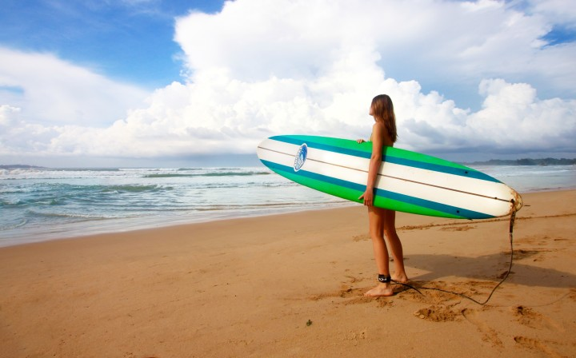
BTEC L3 Travel + Tourism
Unit 1: The World of Travel + Tourism
Learning Aim A: Types of Travel + Tourism
A1. Types of Tourism
A2. Types of Travel
A3. Types of Travel + Tourism Customers

