Slide 1
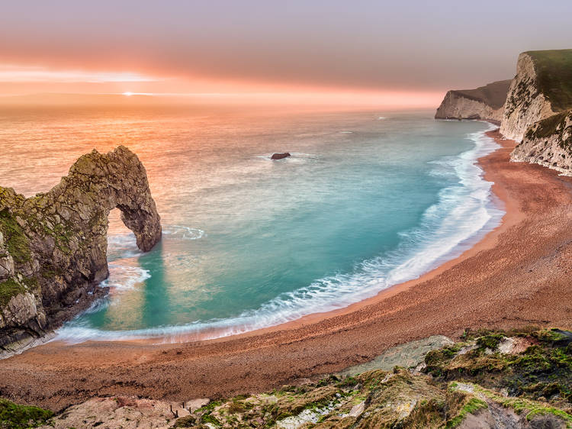
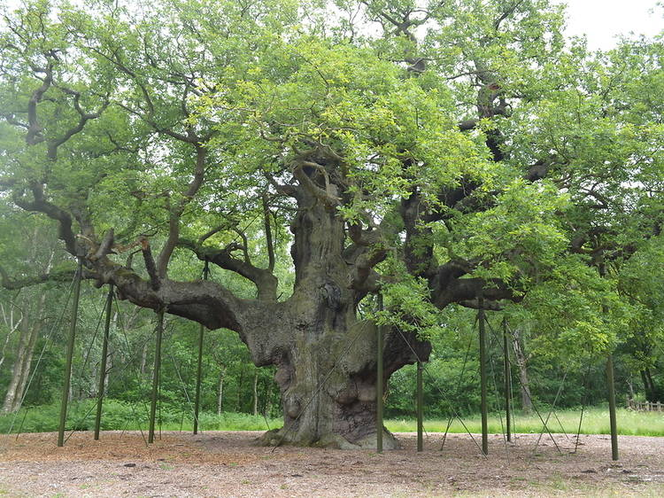
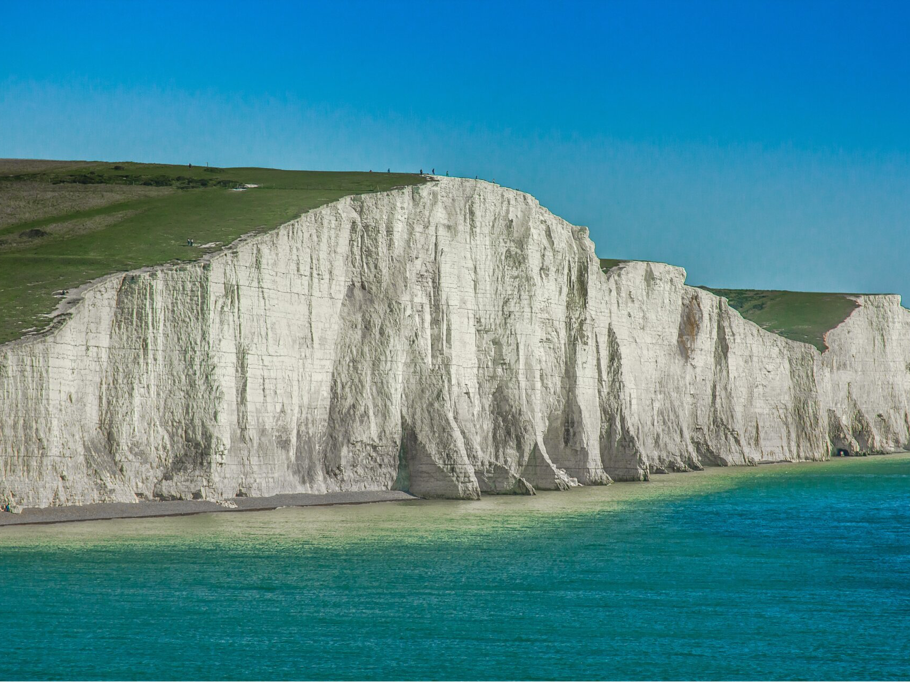
1 | 2 | 3 | 4
6 | 7 | 8 | 9
11 | 12 | 13 | 14
16 | 17 | 18 | 19
Travel + Tourism
UK Natural Attractions
1

Slide 2
1 | 2 | 3 | 4
6 | 7 | 8 | 9
11 | 12 | 13 | 14
16 | 17 | 18 | 19
Travel + Tourism
UK Natural Attractions
2

Slide 3
1 | 2 | 3 | 4
6 | 7 | 8 | 9
11 | 12 | 13 | 14
16 | 17 | 18 | 19
Travel + Tourism
UK Natural Attractions
3

Slide 4
1 | 2 | 3 | 4
6 | 7 | 8 | 9
11 | 12 | 13 | 14
16 | 17 | 18 | 19
Travel + Tourism
UK Natural Attractions
4

Slide 5
1 | 2 | 3 | 4
6 | 7 | 8 | 9
11 | 12 | 13 | 14
16 | 17 | 18 | 19
Travel + Tourism
UK Natural Attractions
5

Slide 6
1 | 2 | 3 | 4
6 | 7 | 8 | 9
11 | 12 | 13 | 14
16 | 17 | 18 | 19
Travel + Tourism
UK Natural Attractions
6

Slide 7
1 | 2 | 3 | 4
6 | 7 | 8 | 9
11 | 12 | 13 | 14
16 | 17 | 18 | 19
Travel + Tourism
UK Natural Attractions
7

Slide 8
1 | 2 | 3 | 4
6 | 7 | 8 | 9
11 | 12 | 13 | 14
16 | 17 | 18 | 19
Travel + Tourism
UK Natural Attractions
8

Slide 9
1 | 2 | 3 | 4
6 | 7 | 8 | 9
11 | 12 | 13 | 14
16 | 17 | 18 | 19
Travel + Tourism
UK Natural Attractions
8

Slide 10
1 | 2 | 3 | 4
6 | 7 | 8 | 9
11 | 12 | 13 | 14
16 | 17 | 18 | 19
Travel + Tourism
UK Natural Attractions
8

